Slide 1
Module III Application layer
DNS, Electronic mail, MIME, SNMP. Introduction to World Wide Web.
VoIP - H.323, SIP standards, Gatekeeper.

Slide 2
DNS
DNS - The Domain Name System
addresses are hard for people to remember
if ISP or organization moves the mail server to a different machine with a different IP address, e-mail address has to change.
ASCII names were introduced to decouple machine names from machine addresses
network understands only numerical addresses,
so some mechanism is required to convert the ASCII strings to network addresses
Earlier, a file, hosts.txt, that listed all the hosts and their IP addresses was used
Problem: size of the file became too large
To solve these problems, DNS was invented

Slide 3
DNS
Essence of DNS
the invention of a hierarchical, domain-based naming scheme and a distributed database system for implementing this naming scheme.
primarily used for mapping host names and e-mail destinations to IP addresses
Working:
To map a name onto an IP address, an application program calls a library procedure called the resolver, passing it the name as a parameter
resolver sends a UDP packet to a local DNS server, which then looks up the name and returns the IP address to the resolver, which then returns it to the caller.
with the IP address, the program can then establish a TCP connection with the destination or send it UDP packets

Slide 4
DNS
DNS Name Space
Managing a large and constantly changing set of names is a crucial problem
Internet is divided into over 200 top-level domains,
where each domain covers many hosts.
Each domain is partitioned into sub domains, and these are further partitioned, and so on.
All these domains can be represented by a tree, as shown

Slide 5
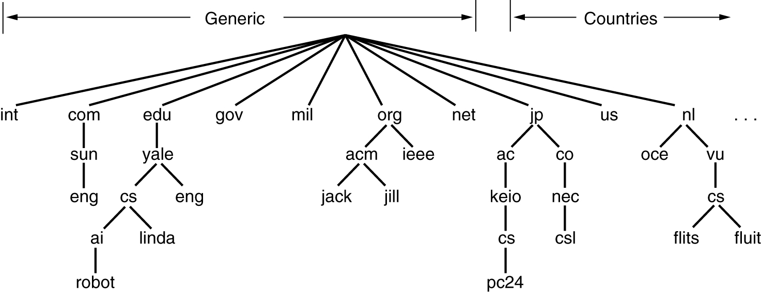
DNS
Fig: A portion of the Internet domain name space.

Slide 6
DNS
top-level domains come in two flavors:
generic and countries.
original generic domains were
com (commercial),
edu (educational institutions),
gov (the U.S. Federal Government),
int (certain international organizations),
mil (the U.S. armed forces),
net (network providers), and
org (nonprofit organizations).
country domains include one entry for every country

Slide 7
DNS
ICANN approved four new, general-purpose, top-level domains, namely,
biz (businesses),
info (information),
name (people's names), and
pro (professions, such as doctors and lawyers).
In addition, three more specialized top-level domains were introduced at the request of certain industries.
aero (aerospace industry),
coop (co-operatives), and
museum (museums).
Other top-level domains will be added in the future
For locating people, resources, services, or objects , another directory service called LDAP (Lightweight Directory Access Protocol) has been defined

Slide 8
DNS
Each domain is named by the path upward from it to the (unnamed) root.
The components are separated by periods (pronounced ''dot'').
Thus, the engineering department at Sun Microsystems might be eng.sun.com
Domain names can be either absolute or relative.
An absolute domain name always ends with a period (e.g., eng.sun.com.), whereas a relative one does not.
Domain names are case insensitive,
so edu, Edu, and EDU mean the same thing.
Component names can be up to 63 characters long, and full path names must not exceed 255 characters.

Slide 9
DNS
To create a new domain, permission is required of the domain in which it will be included.
Once a new domain has been created and registered, it can create subdomains without getting permission from anybody higher up the tree.
Naming follows organizational boundaries, not physical networks
Resource Records
Every domain, whether it is a single host or a top-level domain, can have a set of resource records associated with it.
For a single host, the most common resource record is just its IP address

Slide 10
DNS
When a resolver gives a domain name to DNS, what it gets back are the resource records associated with that name.
Thus, the primary function of DNS is to map domain names onto resource records.
A resource record is a five-tuple.
Although they are encoded in binary for efficiency,
in most descriptions, resource records are presented as ASCII text, one line per resource record.
The format is as follows:
Domain_name Time_to_live Class Type Value
Domain_name tells the domain to which this record applies
Time_to_live field gives an indication of how stable the record is

Slide 11
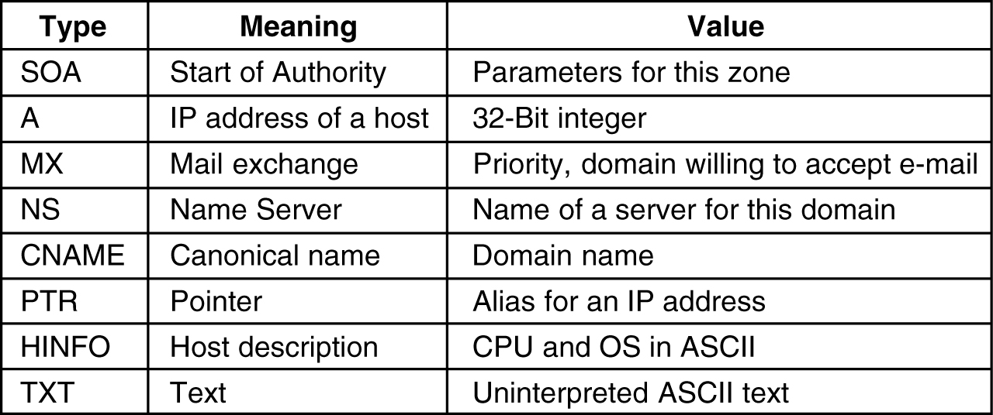
DNS
Class field: For Internet information, it is always IN
Type field tells what kind of record this is
Value field. This field can be a number, a domain name, or an ASCII string. The semantics depend on the record type
Fig: principal DNS resource records types.

Slide 12
DNS
Name Servers
In theory, a single name server could contain the entire DNS database and respond to all queries about it.
In practice, this server would be so overloaded.
Furthermore, if it ever went down, the entire Internet would be collapsed
To avoid the problems associated with having only a single source of information, the DNS name space is divided into nonoverlapping zones
One possible way to divide the name space into zones
Each zone contains some part of the tree and also contains name servers holding the information about that zone.

Slide 13
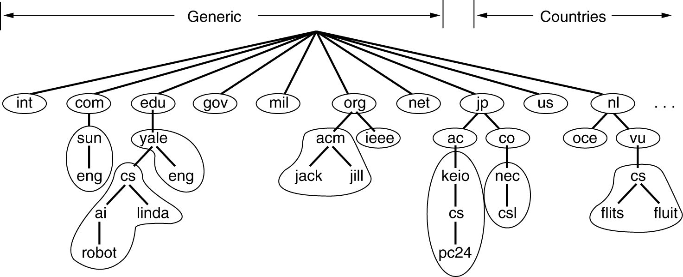
DNS
Normally, a zone will have one primary name server, which gets its information from a file on its disk, and
one or more secondary name servers, which get their information from the primary name server
To improve reliability, some servers for a zone can be located outside the zone
Fig: Part of the DNS name space showing the division into zones

Slide 14
Electronic Mail
Electronic mail or e-mail: (Assignment III)
snail mails (paper letters) are getting overruled by e-mails
The first e-mail systems simply consisted of file transfer protocols,
with the convention that the first line of each message (i.e., file) contained the recipient's address.
Some of the complaints were as follows
Sending a message to a group of people was inconvenient
Messages had no internal structure, making computer processing difficult
The originator (sender) never knew if a message arrived or not
Transferring mails to other person was not possible
user interface was poorly integrated with the transmission system (edit a file, then leave the editor and invoke the file transfer program)
not possible to create and send messages containing a mixture of text, drawings, facsimile, and voice

Slide 15
Electronic Mail
Architecture and Services
overview of what e-mail systems can do and how they are organized
two subsystems:
the user agents
which allow people to read and send e-mail
They are local programs that provide a command-based, menu-based, or graphical method for interacting with the e-mail system
the message transfer agents
which move the messages from the source to the destination.
They are typically system daemons, which are processes that run in the background.
Their job is to move e-mail through the system

Slide 16
Electronic Mail
e-mail systems support five basic functions
Composition refers to the process of creating messages and answers
Transfer refers to moving messages from the originator to the recipient
Reporting has to do with telling the originator what happened to the message
Displaying incoming messages is needed so people can read their e-mail
Disposition is the final step and concerns what the recipient does with the message after receiving it
throwing it away before reading, throwing it away after reading, saving it, and so on

Slide 17
Electronic Mail
Most systems allow users to create mailboxes to store incoming e-mail
Corporate managers often need to send a message to each of their subordinates, customers, or suppliers
Achieved by maintaining a mailing list, which is a list of e-mail addresses.
envelope encapsulates the message
contains all the information needed for transporting the message, such as the destination address, priority, and security level, all of which are distinct from the message itself.
message transport agents use the envelope for routing

Slide 18
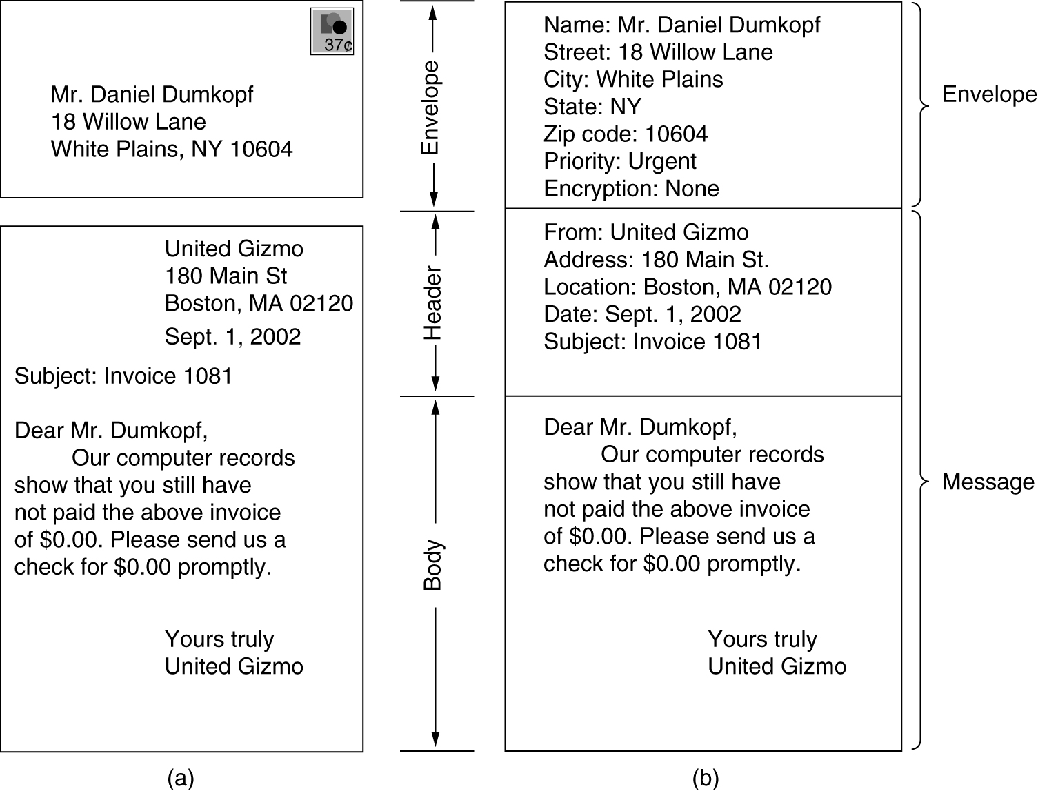
Electronic Mail
message inside the envelope consists of two parts: the header and the body.
header contains control information for the user agents.
body is entirely for the human recipient
Fig: Envelopes and messages.
Paper mail.
(b) Electronic mail.

Slide 19
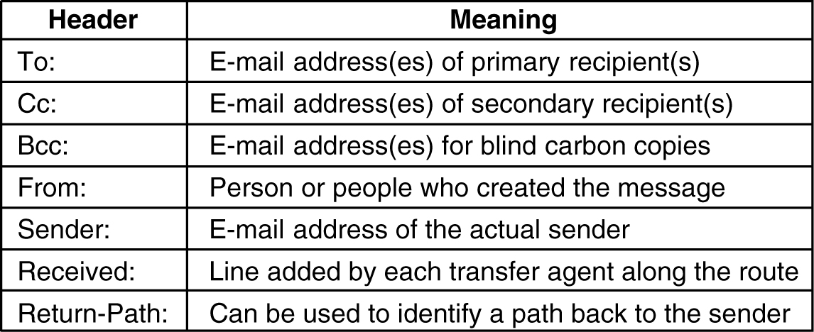
Electronic Mail
user agent
normally a program (sometimes called a mail reader) that accepts a variety of commands for composing, receiving, and replying to messages, as well as for manipulating mailboxes
Write about
Sending E-mail
Reading E-mail
Fig: RFC 822 header fields related to message transport.

Slide 20
MIME
MIME - The Multipurpose Internet Mail Extensions
In the early days of the ARPANET, e-mail consisted exclusively of text messages written in English and expressed in ASCII.
For this environment, RFC 822 did the job completely:
it specified the headers but left the content entirely up to the users.
Nowadays, on the worldwide Internet, this approach is no longer adequate.
The problems include sending and receiving
1. Messages in languages with accents (e.g., French and German).
2. Messages in non-Latin alphabets (e.g., Hebrew and Russian).
3. Messages in languages without alphabets (e.g., Chinese and Japanese).
4. Messages not containing text at all (e.g., audio or images).

Slide 21
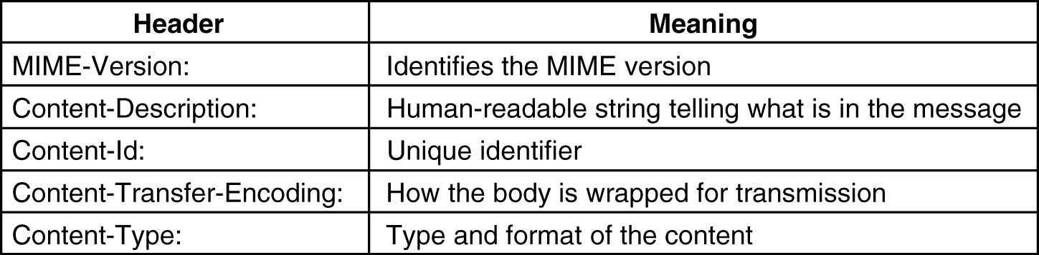
MIME
basic idea of MIME
to continue to use the RFC 822 format,
but to add structure to the message body and define encoding rules for non-ASCII messages.
MIME messages can be sent using the existing mail programs and protocols.
All that has to be changed are the sending and receiving programs, which users can do for themselves
MIME defines five new message headers
Fig: RFC 822 headers added by MIME.

Slide 22
MIME
correct way to encode binary messages is to use base64 encoding, sometimes called ASCII armor.
coding is ''A'' for 0, ''B'' for 1, and so on, followed by the 26 lower-case letters, the ten digits, and finally + and / for 62 and 63, respectively
Carriage returns and line feeds are ignored, so they can be inserted at will to keep the lines short enough.
For messages that are almost entirely ASCII but with a few non-ASCII characters, base64 encoding is somewhat inefficient.
Instead, an encoding known as quoted-printable encoding is used.
This is just 7-bit ASCII, with all the characters above 127 encoded as an equal sign followed by the character's value as two hexadecimal digits.

Slide 23
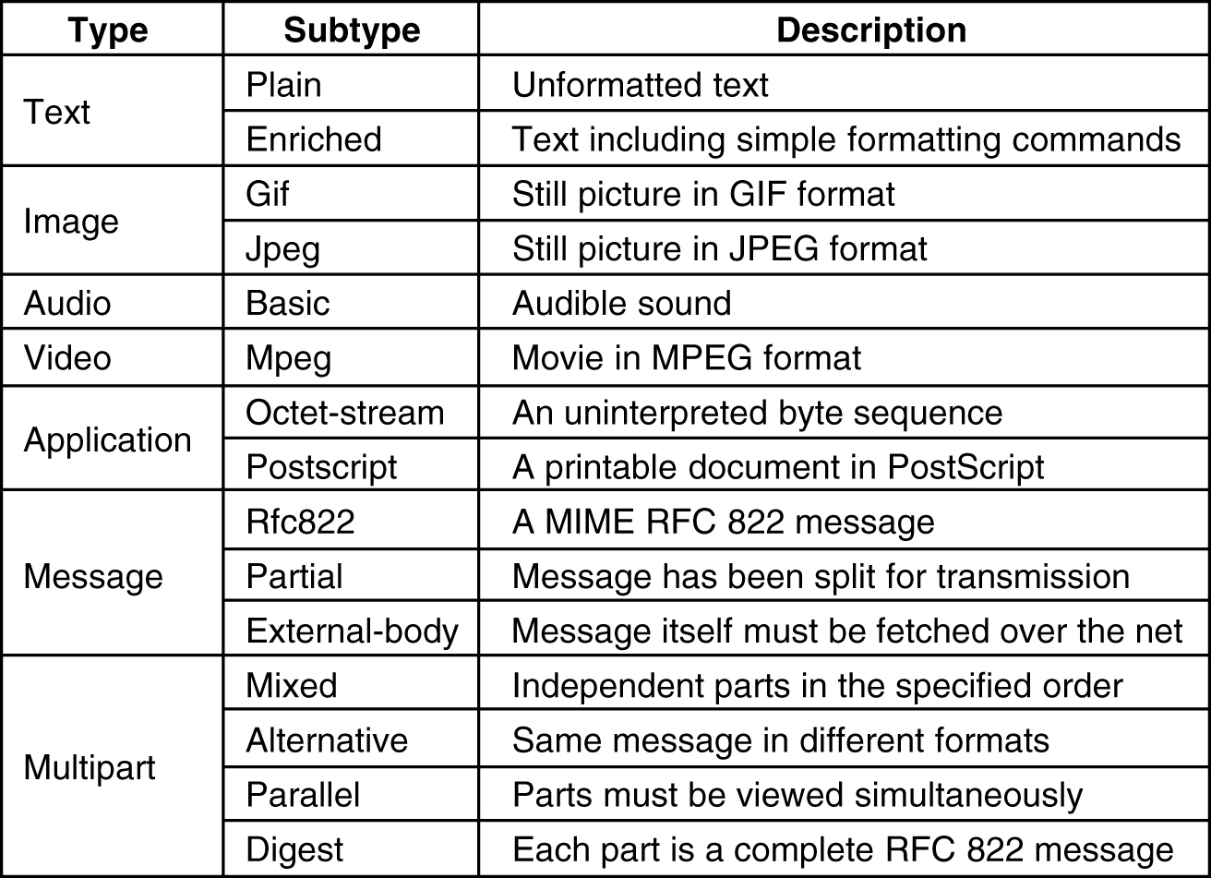
MIME
Fig: MIME types and subtypes

Slide 24
SMTP
SMTP - The Simple Mail Transfer Protocol
Within the Internet, e-mail is delivered by having the source machine establish a TCP connection to port 25 of the destination machine.
Listening to this port is an e-mail daemon that speaks SMTP (Simple Mail Transfer Protocol).
This daemon accepts incoming connections and copies messages from them into the appropriate mailboxes.
If a message cannot be delivered, an error report containing the first part of the undeliverable message is returned to the sender

Slide 25
SNMP
Simple Network Management Protocol (SNMP)
Internet-standard protocol for managing devices on IP networks
have the task of monitoring or managing a group of hosts or devices on a computer network.
Devices that typically support SNMP include routers, switches, servers, workstations, printers, modem racks and more
SNMP is used mostly in network management systems to monitor network-attached devices for conditions that warrant administrative attention.
It consists of a set of standards for network management, including an application layer protocol, a database schema, and a set of data objects.

Slide 26
SNMP
An SNMP-managed network consists of three key components:
Managed device
network node that implements an SNMP interface that allows unidirectional (read-only) or bidirectional (read and write) access to node-specific information
exchange node-specific information with the NMS
Egs: routers, access servers, switches, bridges, hubs, IP telephones, IP video cameras, computer hosts, and printers.
Agent
software which runs on managed devices
has local knowledge of management information & translates that information to or from an SNMP-specific form

Slide 27
SNMP
Network management station (NMS)
software which runs on the manager
executes applications that monitor and control managed devices
provide the bulk of the processing and memory resources required for network management
One or more NMSs may exist on any managed network

Slide 28
WWW
World Wide Web (Assignment III)
architectural framework for accessing linked documents spread out over millions of machines all over the Internet
Architectural Overview
From the users' point of view, the Web consists of a vast, worldwide collection of documents or Web pages, often just called pages.
Each page may contain links to other pages anywhere in the world.
Users can follow a link by clicking on it, which then takes them to the page pointed to.
This process can be repeated indefinitely.
The idea of having one page point to another is called hypertext

Slide 29
WWW
Pages are viewed with a program called a browser
Egs: Internet Explorer and Netscape Navigator
The browser fetches the page requested, interprets the text and formatting commands on it, and displays the page, properly formatted, on the screen
Strings of text that are links to other pages, called hyperlinks,
Hyperlinks are often highlighted, by underlining, displaying them in a special color, or both.
To follow a link, the user places the mouse cursor on the highlighted area, which causes the cursor to change, and clicks on it

Slide 30
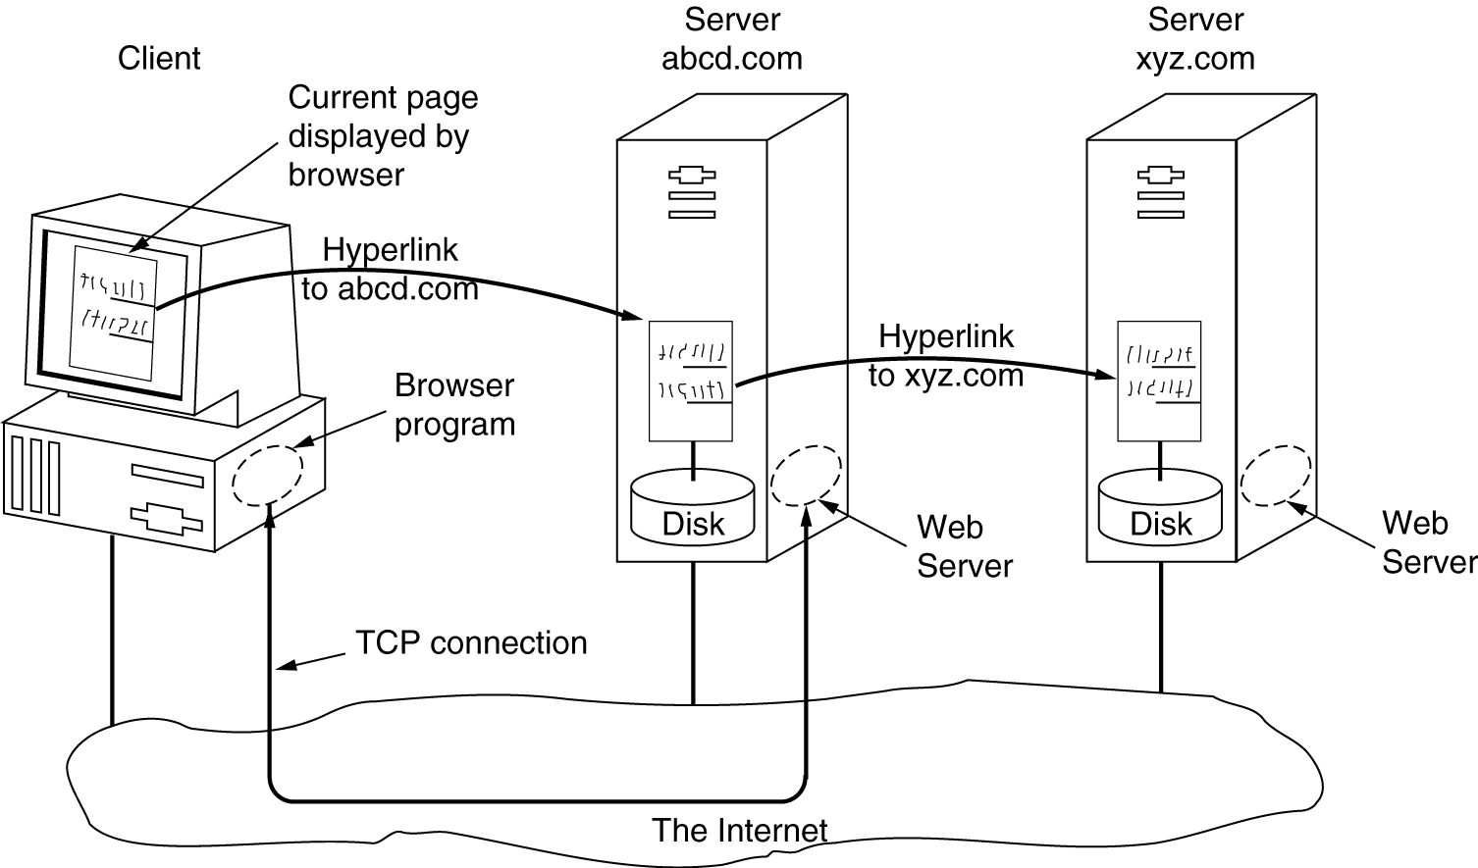
WWW
Fig: parts of the Web model

Slide 31
WWW
Client Side
browser is a program that can display a Web page and catch mouse clicks to items on the displayed page.
When an item is selected, the browser follows the hyperlink and fetches the page selected.
Therefore, the embedded hyperlink needs a way to name any other page on the Web.
Pages are named using URLs (Uniform Resource Locators).
A typical URL is
http://www.abcd.com

Slide 32
WWW
When a user clicks on a hyperlink, the browser carries out a series of steps in order to fetch the page pointed to.
Suppose that a user is browsing the Web with URL, http://www.itu.org/home/index.html.
Let us trace the steps that occur when this link is selected.
1. The browser determines the URL
2. The browser asks DNS for the IP address of www.itu.org.
3. DNS replies with 156.106.192.32.
4. The browser makes a TCP connection to port 80 on 156.106.192.32.
5. It then sends over a request asking for file /home/index.html.
6. The www.itu.org server sends the file /home/index.html.
7. The TCP connection is released.
8. The browser displays all the text in /home/index.html.
9. The browser fetches and displays all images in this file.

Slide 33
WWW
To allow all browsers to understand all Web pages, Web pages are written in a standardized language called HTML, which describes Web pages
Although a browser is basically an HTML interpreter, most browsers have numerous buttons and features to make it easier to navigate the Web.
Button for going back to the previous page,
button for going forward to the next page and
button for going straight to the user's own start page.
button or menu item to set a bookmark on a given page
button to display the list of bookmarks,
Pages can also be saved to disk or printed.
Numerous options are generally available for controlling the screen layout and setting various user preferences.

Slide 34
WWW
A page may consist of
formatted document in PDF format,
icon in GIF format,
photograph in JPEG format,
song in MP3 format,
video in MPEG format, or
any one of hundreds of other file types
Server Side
steps that the server performs in its main loop are:
1. Accept a TCP connection from a client (a browser).
2. Get the name of the file requested.
3. Get the file (from disk).
4. Return the file to the client.
5. Release the TCP connection.

Slide 35
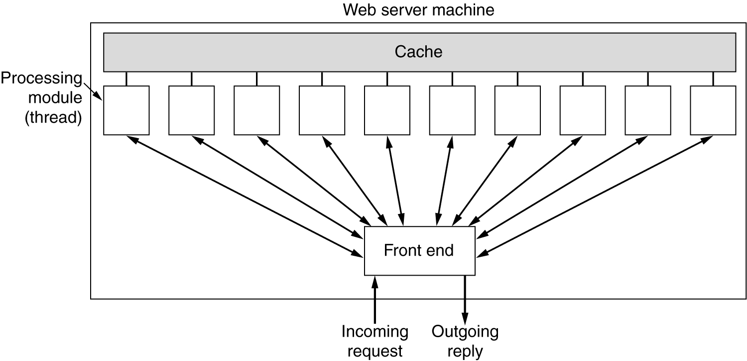
WWW
Web server cannot serve more requests per second than it can make disk accesses
One obvious improvement (used by all Web servers) is to maintain a cache in memory of the n most recently used files
Second improvement is to make the server multithreaded
Fig: A multithreaded Web server with a front end and processing modules

Slide 36
WWW
Different Processing Modules can be
1. Resolve the name of the Web page requested.
2. Authenticate the client.
3. Perform access control on the client.
4. Perform access control on the Web page.
5. Check the cache.
6. Fetch the requested page from disk.
7. Determine the MIME type to include in the response.
8. Take care of miscellaneous odds and ends.
9. Return the reply to the client.
10. Make an entry in the server log.

Slide 37
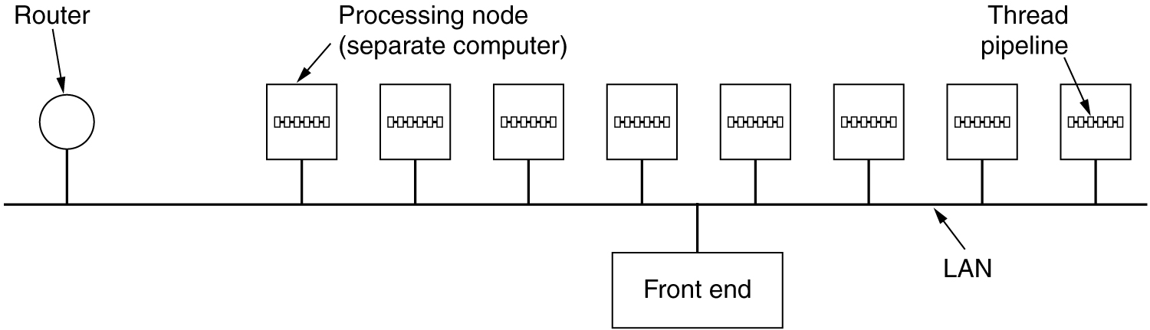
WWW
If too many requests come in each second, the CPU will not be able to handle the processing load, no matter how many disks are used in parallel.
The solution is to add more nodes (computers), possibly with replicated disks to avoid having the disks become the next bottleneck.
This leads to the server farm model
Fig: A server farm.

Slide 38
WWW
A front end still accepts incoming requests but sprays them over multiple CPUs rather than multiple threads to reduce the load on each computer.
The individual machines may themselves be multithreaded and pipelined
One problem with server farms is that there is no longer a shared cache because each processing node has its own memory
Solution: an expensive shared-memory multiprocessor can be used.
Another problem with server farms is that the client's TCP connection terminates at the front end, so the reply must go through the front end
Solution: TCP handoff - TCP end point is passed to the processing node so it can reply directly to the client

Slide 39
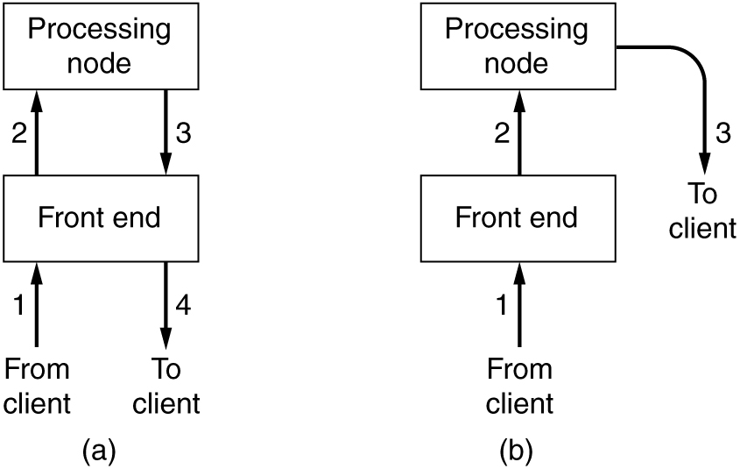
WWW
(a) Normal request-reply message sequence.
(b) Sequence when TCP handoff is used.

Slide 40
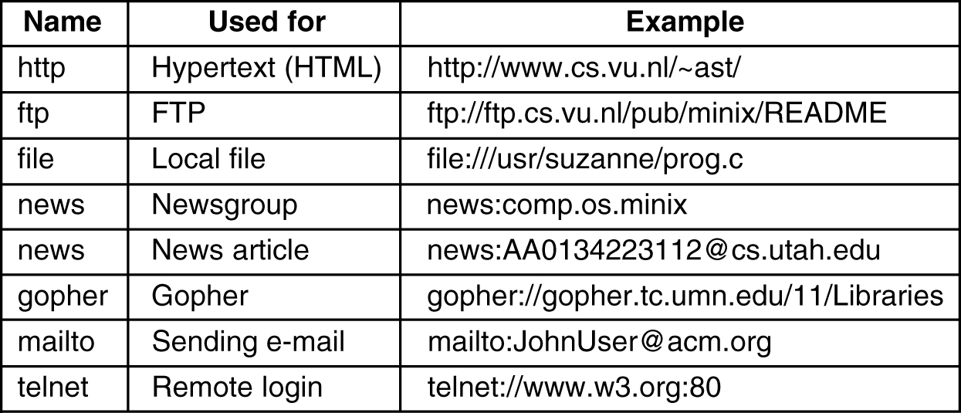
WWW
Fig: Some common URLs.

Slide 41
Voice over IP
Voice over IP
many packet-switching network operators suddenly became interested in carrying voice over their data networks.
The amount of additional bandwidth required for voice is minuscule since the packet networks are dimensioned for the data traffic.
However, the average person's phone bill is probably larger than his Internet bill,
so the data network operators saw Internet telephony as a way to earn a large amount of additional money without having to put any new fiber in the ground.
Thus Internet telephony (also known as voice over IP), was born.

Slide 42
Voice over IP
H.323
H.323 entitled ''Visual Telephone Systems and Equipment for Local Area Networks Which Provide a Non-Guaranteed Quality of Service.''
revised H.323 was the basis for the first widespread Internet telephony systems
It references a large number of specific protocols for speech coding, call setup, signaling, data transport, and other areas rather than specifying these things itself

Slide 43
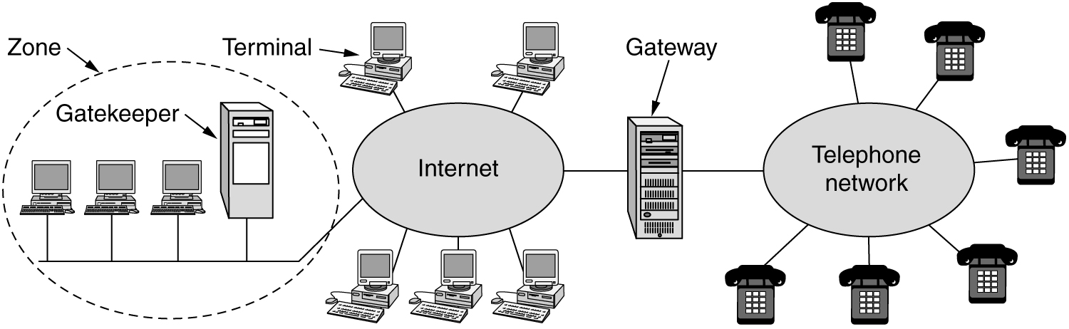
Voice over IP
At the center is a gateway that connects the Internet to the telephone network.
It speaks the H.323 protocols on the Internet side and the PSTN protocols on the telephone side.
The communicating devices are called terminals.
A LAN may have a gatekeeper, which controls the end points under its jurisdiction, called a zone.
Fig: H323 architectural model for Internet telephony

Slide 44
SIP Standards
SIP - Session Initiation Protocol
H.323 was designed by ITU.
Many people in the Internet community saw it as a typical telco product: large, complex, and inflexible.
Consequently, IETF set up a committee to design a simpler and more modular way to do voice over IP.
The major result is the SIP (Session Initiation Protocol)
This protocol describes how to set up Internet telephone calls, video conferences, and other multimedia connections.
Unlike H.323, which is a complete protocol suite, SIP is a single module,
but it has been designed to interwork well with existing Internet applications.

Slide 45
SIP Standards
For example, it defines telephone numbers as URLs, so that Web pages can contain them, allowing a click on a link to initiate a telephone call
SIP can establish
two-party sessions (ordinary telephone calls),
multiparty sessions (where everyone can hear and speak), and
multicast sessions (one sender, many receivers).
The sessions may contain audio, video, or data, the latter being useful for multiplayer real-time games, for example.
SIP just handles setup, management, and termination of sessions.
Other protocols, like RTP, are used for data transport.
SIP is an application-layer protocol and can run over UDP or TCP.

Slide 46
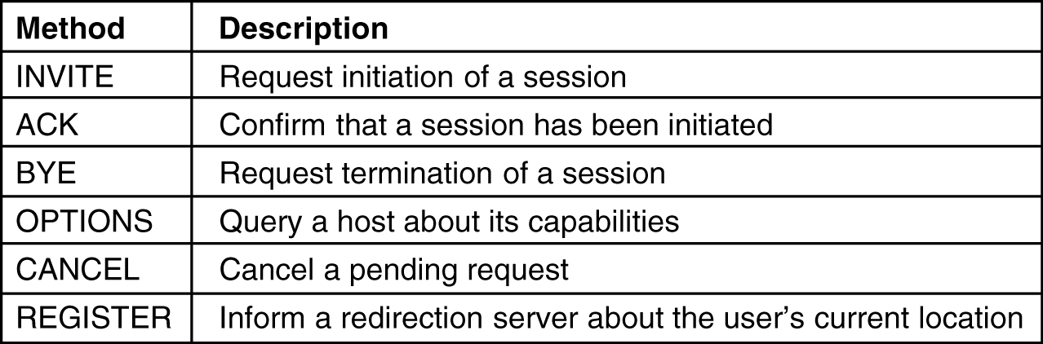
SIP Standards
SIP protocol is a text-based protocol modeled on HTTP.
One party sends a message in ASCII text consisting of a method name on the first line, followed by additional lines containing headers for passing parameters.
Many of the headers are taken from MIME to allow SIP to interwork with existing Internet applications.
Fig: SIP methods defined

Slide 47
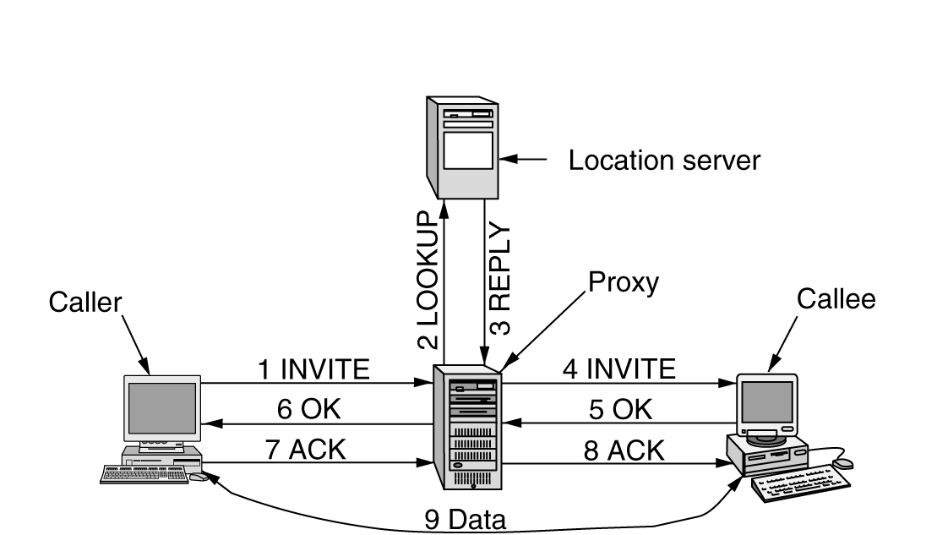
SIP Standards
Fig: Use a proxy and redirection servers with SIP.

Slide 48
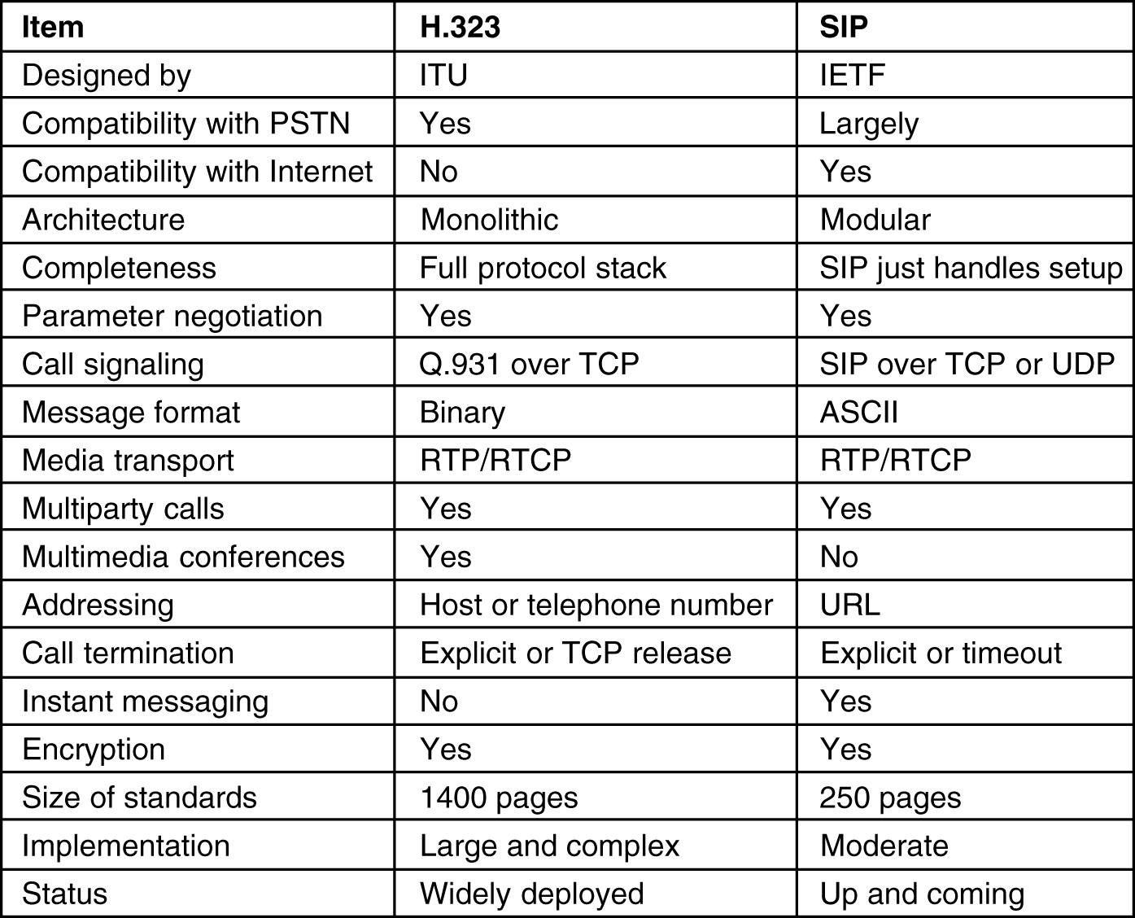
SIP Standards
Comparison of H.323 and SIP

